Slide 1



Department of Computer Science and Engineering
SPEECH EMOTION RECOGNITION
S.YAMINI (211419104312)
NILOPHER NISHA M (211419104242)
Guided by
Dr.T.TAMILVIZHI,M.TECH., Ph.D.,
ASSOCIATE PROFESSOR,
DEPARTMENT OF CSE,
PANIMALAR ENGINEERING COLLEGE.
Coordinator
DR.K.VALARMATHI,
ASSOCIATE PROFESSOR,
DEPARTMENT OF CSE,
PANIMALAR ENGINEERING COLLEGE.

Slide 2
Introduction
Emotions are the best indicators of the actions of humans in advance. It is of great advantage in the current smart world. Prediction of these emotions can be able to sense the current mood of the driver and control the smart automobile accordingly and can be used in case of chatting with the customers using AI devices,etc.This can be done by extracting the features(including MFCC) of the respective emotions and train the learning model using the classification algorithms(CNN) and eventually the model can predict the emotion by comparing the newly retrieved features and the features of the training dataset and classify them accordingly.

Slide 3
Objective of the Project
The objective of the proposed system is to detect emotions from continuous and spontaneous speech. Speech emotion recognition can be of huge help to prevent cyber crimes and can regulate the smart automobiles according to the emotion assessed from the driver. Other applications can include the chatbots for better understanding of the customers on the other side, audio surveillance, online marketing, call centers, etc. Mel-frequency cepstrum coefficient (MFCC) is the most used representation of the spectral property of voice signals. These are the best for speech recognition as it takes human perception sensitivity with respect to frequencies into consideration. MFCC features are extracted from the speech signals and are used to train different classifiers and feature selection is a crucial step to select the most relevant features out of it. A classifier model is built using Convolutional Neural Networks (CNN) algorithm which proves to be the better deep learning algorithm for processing and recognition tasks.

Slide 4
Literature Survey
TITLE | AUTHOR NAME | PAPER DETAILS | METHODOLOGY | YEAR OF PUBLISH
Speech emotion and naturalness recognition system | Bagus Tris Atmaja, Akira Sasou and Masato Akagi, | Naturalness recognition from the speech is a new application of speech processing technique to predict the degree of naturalness score from unnatural to very natural scores for an utterance.First, ability to multitask learning dimensional emotions is shown and naturalness scores simultaneously with a small loss in naturalness recognition performance scores. Second, we evaluated our models in a 6-fold cross validation evaluation to fill the gap in the previous studies, which only evaluated the performance of the models on a single fold. | Two classifiers-Multilayer perceptron and long short-term memory networks are used. This simple MLP is trained on 200 maximum iterations (epoch) with ten patiences and the model is implemented with LSTM and Dense layers in the Tensorflow toolkit . | 2022

Slide 5
Literature Survey
TITLE | AUTHOR NAME | PAPER DETAILS | METHODOLOGY | YEAR OF PUBLISH
Speech Emotion Recognition system based on Self-Attention Weight Correction for Acoustic and Text Features | Jennifer Santosoand Takeshi Yamada | proposed SAWC reduces the importance of words with speech recognition error in the text feature while emphasizing the importance of speech segments containing these words in acoustic features. evaluate the effectiveness of the SAWC in each feature extractor in improving the SER performance. proposed SAWC reduces the importance of words with speech recognition error in the text feature while emphasizing the importance of speech segments containing these words in acoustic features. | We propose a method to improve the basic SER method by adjusting the self-attention weights using CM and named this method self-attention weight correction (SAWC). | 2022

Slide 6
Literature Survey
TITLE | AUTHOR NAME | PAPER DETAILS | METHODOLOGY | YEAR OF PUBLISH
Design of Efficient Speech Emotion Recognition Based on Multi Task Learning | Liu Yunxiang;Zhang Kexin | This paper used two multi-task learning models based on adversarial multi-task learning(ASP-MTL). The first model took emotion recognition as the main task and noise recognition as the auxiliary task, and removed the noise part identified by the auxiliary task. After identifying the non-noise part, the second model was constructed. The second model took emotion recognition as the main task and gender classification as the auxiliary task. These two multi-task learning models can not only use shared information to learn the relationship between different tasks, but also can identify specific tasks. | Feature space is divided into shared LSTM and private LSTM, which are used to extract shared features and private features respectively. ASP-MTL model is divided into feature extraction layer, confrontation and orthogonal constraint layer and specific task layer. | 2032

Slide 7
Problem Statement
The objective of the proposed system is to detect emotions from continuous and spontaneous speech. Speech emotion recognition can be of huge help to prevent cyber crimes and can regulate the smart automobiles according to the emotion assessed from the driver. Other applications can include the chatbots for better understanding of the customers on the other side, audio surveillance, online marketing, call centers, etc. Mel-frequency cepstrum coefficient (MFCC) is the most used representation of the spectral property of voice signals. These are the best for speech recognition as it takes human perception sensitivity with respect to frequencies into consideration. MFCC features are extracted from the speech signals and are used to train different classifiers and feature selection is a crucial step to select the most relevant features out of it. A classifier model is built using Convolutional Neural Networks (CNN) algorithm which proves to be the better deep learning algorithm for processing and recognition tasks.

Slide 8
Proposed System
Proposed system includes the following steps
Inputting the audio signal
Feature extraction
Feature enhancement
Classifier training
Emotion detection
The audio signal input is preprocessed before feature extraction to remove unwanted noise signal.The features are extracted using MFCC technique .Other techniques are LPC and PLP.Classification is performed which maps the features to emotion. CNN is used for classifying the emotions which shows a larger learning rate .

Slide 9
Audio speech signals are inputted and Librosa library in Python is used to process and extract features from the audio files using MFCC which are widely used in automatic speech and speaker recognition.The signal is processed through the Fast Fourier Transform which uses less computational time and used to assess the frequency properties of a signal.FFT is just another version of DFT but more efficient and faster.The typical applications of FFT are compression in more complex processing of signals and filtering ,remodeling of signals,etc.
ADVANTAGES
CNN is used for classifying the emotions which shows a larger learning rate .
The main advantage of CNN compared to its predecessors is that it automatically detects the important features without any human supervision.
Fast Fourier Transform is faster than the Discrete Fourier Transform

Slide 10
Software / Hardware used
HARDWARE ENVIRONMENT
Desktop / Laptop
Processor: Minimum 1 GHz
Memory (RAM): 2 GB
Internet Connection
SOFTWARE ENVIRONMENT
Jupyter Notebook
Python
VS Code
Frameworks-Flask, Torch
Libraries-Pytorch, Pandas, Numpy, MatPlot,Keras.

Slide 11
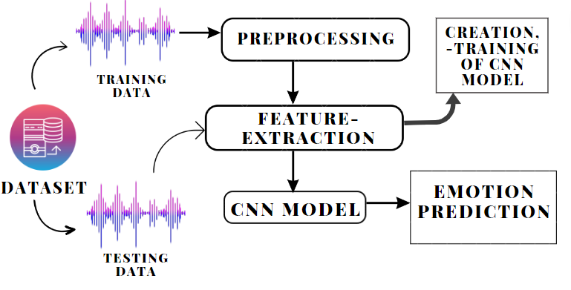
Architecture

Slide 12
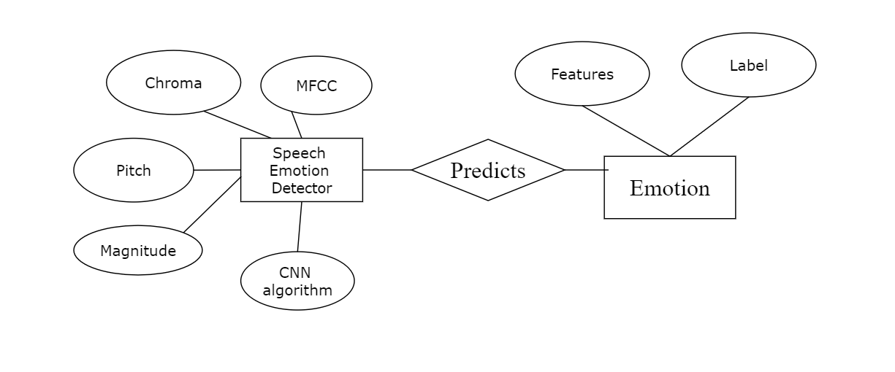
System Design
ER DIAGRAM

Slide 13
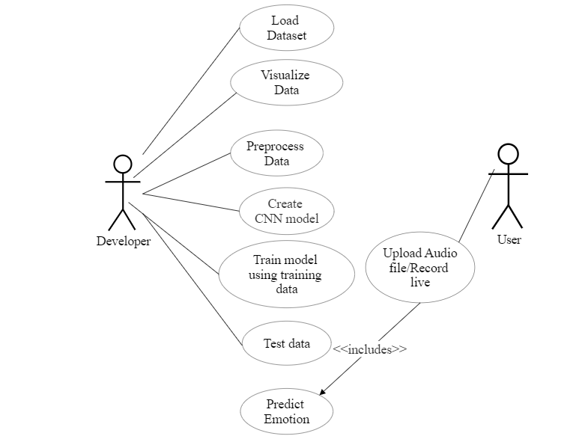
System Design
Use Case diagram

Slide 14
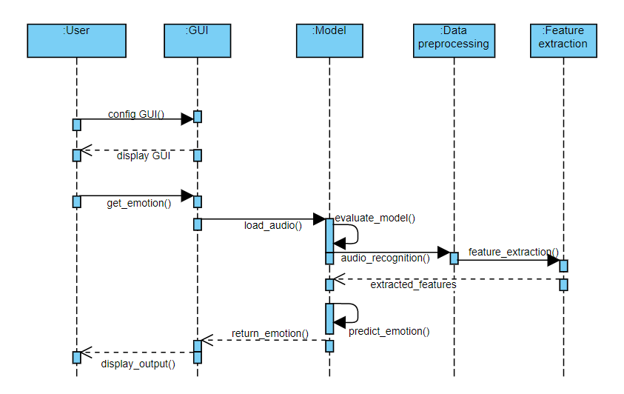
System Design
SEQUENCE DIAGRAM

Slide 15
Module Description
5.1 MODULE DESIGN SPECIFICATION
Data preprocessing
Data Visualization
Feature extraction
Model Creation
Training and Evaluation
Test set Prediction
Deployment

Slide 16
Data Preprocessing
Data preprocessing involves below steps:
Getting the dataset
Importing libraries
Importing datasets
Finding Missing Data
Encoding Categorical Data
Splitting dataset into training and test set
Feature scaling
Librosa and TorchAudio (Pytorch) are two Python packages that are used for audio data pre-processing.

Slide 17
Module Description
Data Visualization
Data visualization is defined as a graphical representation that contains the information and the data.
Data Visualization Libraries used are
Matplotlib
Plotly
Feature Extraction
Audio feature extraction is a necessary step in audio signal processing, which is a subfield of signal processing and deals with the processing or manipulation of audio signals and also removes unwanted noise and balances the time-frequency ranges by converting digital and analog signals.
Deep Learning approach considers unstructured audio representations such as the spectrogram or MFCCs.
Other features extracted are Magnitude, Pitch, Chroma.

Slide 18
Module Description
Model Creation
CNN model is created with Keras and constructed with 5 layers — 4 Conv1D layers followed by a Dense layer.
Training and Evaluation
The developed model is then trained using the training dataset of RAVDESS so that the model is able to predict the emotion.
Testing set Prediction
The model is tested using the testing dataset to analyze the efficiency and accuracy of the model.
Deployment
A deployment model is designed using flask where the user can upload an audio file and the system predicts the respective emotion.

Slide 19
Testing /Performance Evaluation / Results
TEST CASES & REPORTS
TEST CASE ID | TEST CASE / ACTION TO BE PERFORMED | EXPECTED RESULT | ACTUAL RESULT | PASS/ FAIL
1 | Display the Home page by clicking on the Website Link | Display the features of the website | Display the features of the website | Pass
2 | Selecting select file button in home page | Display the name of the audio file | Attach the file and display the name | Pass
3 | Selecting predict button | Display the emotion of the attached audio file | Display the emotion of the attached audio file | Pass

Slide 20
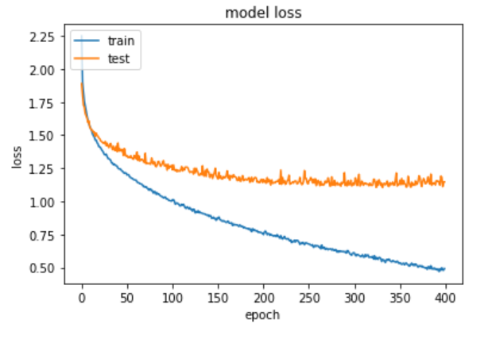
Testing /Performance Evaluation / Results
Hence our project presents a new way to give the ability to machines to determine emotion with the help of the human voice. A deployment model is designed using flask where the user can upload an audio file and the system predicts the respective emotion.The below figure shows the training and testing loss on our dataset. As we can see from the graph, both training and testing errors reduce as the number of epochs to the training model increases.

Slide 21
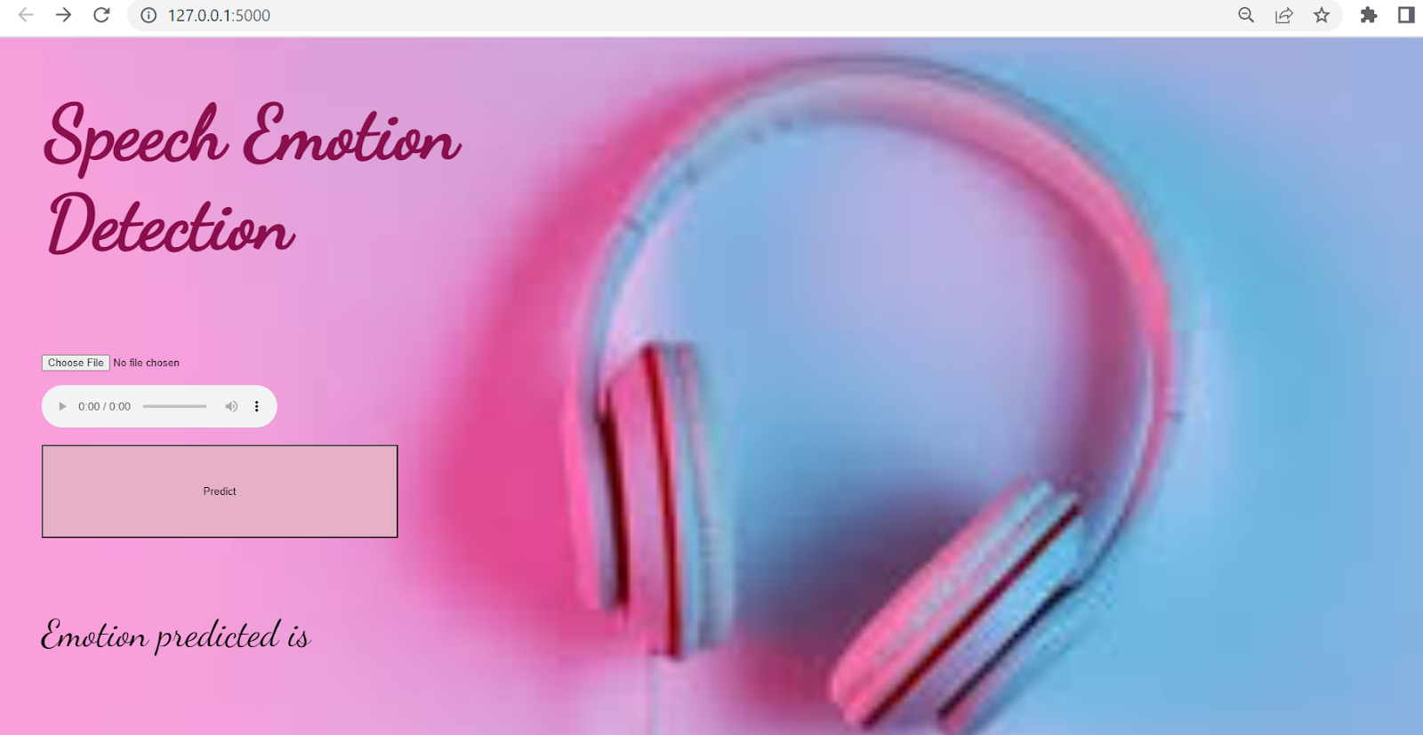
Screen Shots

Slide 22
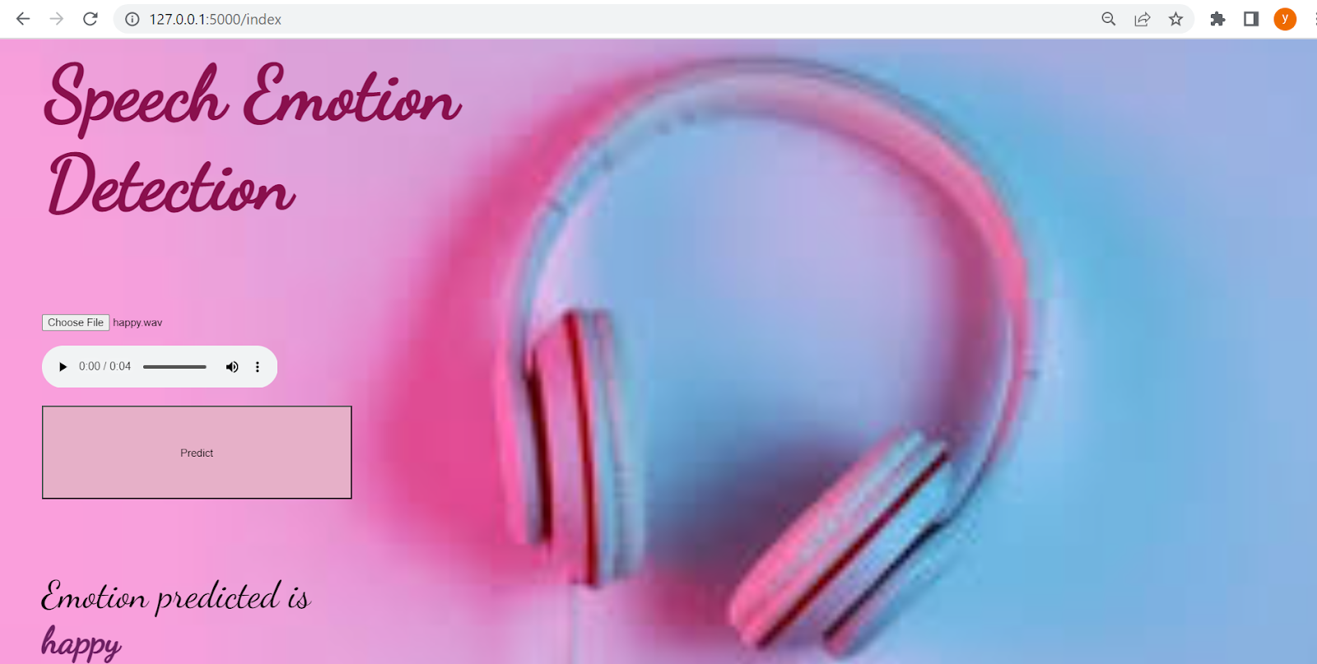
Screen Shots

Slide 23
Conclusion / Feature Enhancement
Thus the proposed system has the capability of understanding the human emotions which contains extra insights about human actions without the actual need for an actual presence and thereby can understand the motives of the people. This system can be further enhanced by combining the facial emotion recognition system with the speech emotion recognition system so that the emotions are predicted more accurately by analyzing both facial and audio-extracted features.

Slide 24
Reference Paper/ URL
Akira Sasou, Bagus Tris Atmaja, and Masato Akagi, “Speech emotion and naturalness recognition system”, vol.10, pp.72381-72387, July 2022.
Jennifer Santosoand Takeshi Yamada, “Speech Emotion Recognition system based on Self-Attention Weight Correction for Acoustic and Text Features”, vol.10, pp.115732-115743, November 2022.
Liu Yunxiang and Zhang Kexin, “Design of Efficient Speech Emotion Recognition Based on Multi Task Learning”, vol.11, pp.5528-5537, January 2023.
Caslon Chua, Felicia Andayani, Lau Bee Theng and Mark Teekit Tsun, “Hybrid LSTM-Transformer Model for Emotion Recognition From Speech Audio Files”, vol.10, pp.36018-36027, March 2022.
Edris Zaman Farsa,Mohammad Reza Falahzadeh,, “3D Convolutional Neural Network for Speech Emotion Recognition With Its Realization on Intel CPU and NVIDIA GPU”, vol.10, pp.112460-112471, October 2022.
Alwin Poulose, Samuel Kakuba,, “Attention-Based Multi-Learning Approach for Speech Emotion Recognition With Dilated Convolution”, vol.10, pp.122302-122313, November 2022.

Slide 25
Alwin Poulose, Samuel Kakuba, “Deep Learning-Based Speech Emotion Recognition Using Multi-Level Fusion of Concurrent Features”, vol.10, pp.125538-125551, November 2022.
Akira Sasou, Bagus Tris Atmaja, “Evaluating Self-Supervised Speech Representations for Speech Emotion Recognition”, vol.10, pp.124396 - 124407, November 2022.
Haiyan Wang, Xiaohui Zhao, “Investigation of the Effect of Increased Dimension Levels in Speech Emotion Recognition”, vol.10, pp.78123-78134, July 2022.
[10]Carlos Busso, Kusha Sridhar,, “Unsupervised Personalization of an Emotion Recognition System: The Unique Properties of the Externalization of Valence in Speech”, vol. 13,pp.1959-1972, December 2022.
Base paper:
https://ieeexplore.ieee.org/stamp/stamp.jsp?tp=&arnumber=9819911

